Slide 1

Subreddit Classification
Techniques
Pleasant Ballenger, Ansh Aryan, Leonardo Atalla, Thomas Smith
Comp 560

Slide 2

Introduction
Mike Swarbrick Jones’ “reddit self-post classification task” dataset reduced to 20 subreddits
Classify reddit posts into subreddits
Compare various classification techniques
Applications in content moderation and recommendation systems
("talesfromtechsupport", "teenmom", "Harley", "ringdoorbell", "intel", "residentevil", "BATProject", "hockeyplayers", "asmr", "rawdenim", "steinsgate", "DBZDokkanBattle", "Nootropics", "l5r", "NameThatSong", "homeless", "antidepressants", "absolver", "Warframe", "fatpeoplestories")​​

Slide 3
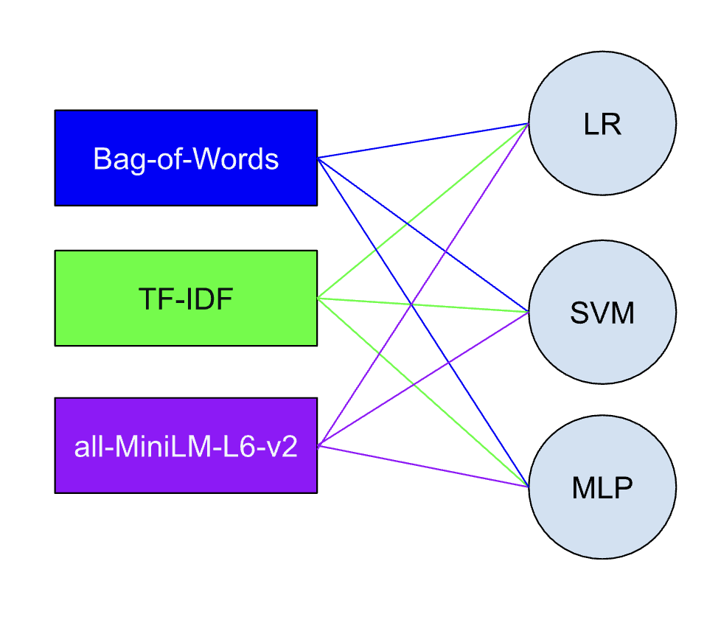
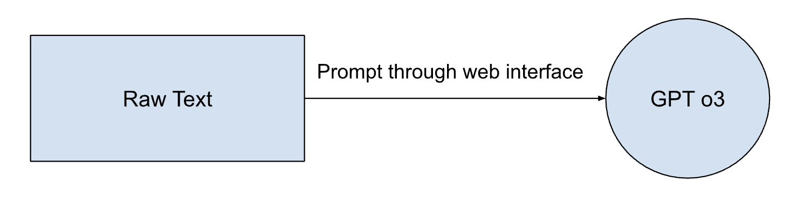
Methodology
Bag-of-words, TF-IDF, and all-MiniLM-L6-v2
Logistic regression, support vector machine, and multi-layer perceptron
Prompting for GPT-o3 classification

Slide 4
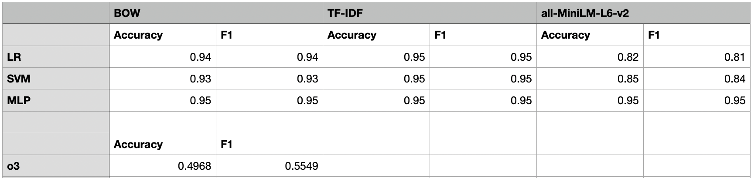
Results
MLP -> all three; LR/SVM -> BoW and TF-IDF. What does this mean?
Frequency representations of words -> logistic regression and SVM
Embeddings are sparse vectors, better for linear models
all-MiniLM-L6-v2 embeddings are dense vectors, better with perceptron architecture, other DL models
o3 performance 👎 (short inputs, no knowledge graph)
To use o3, write an API with OpenAI’s Python tools and Pinecone

